Slide 1
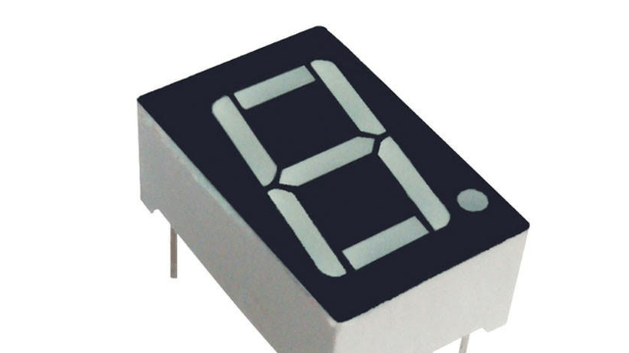
Mapas de Karnaugh de 4 variables
Ing. Mario López

Slide 2
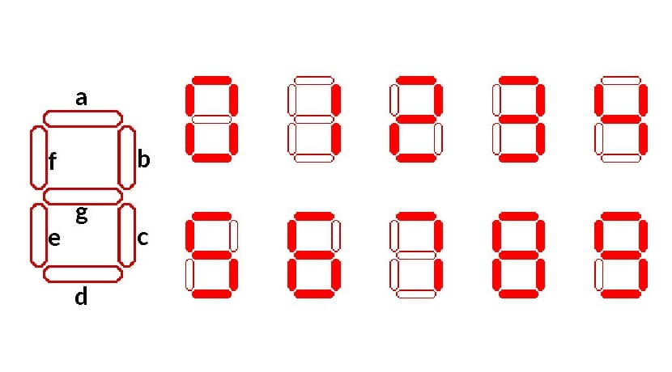
Decodificador BCD (Binary-Coded Decimal) a 7 segmentos
Entrada binaria de 4 variables.
Display a 7 segmentos
cátodo común.
Dígitos decimales a decodificar.

Slide 3
1. Tabla de verdad
Dec | A | B | C | D | a | b | c | d | e | f | g
0 | 0 | 0 | 0 | 0 | 1 | 1 | 1 | 1 | 1 | 1 | 0
1 | 0 | 0 | 0 | 1 | 0 | 1 | 1 | 0 | 0 | 0 | 0
2 | 0 | 0 | 1 | 0 | 1 | 1 | 0 | 1 | 1 | 0 | 1
3 | 0 | 0 | 1 | 1 | 1 | 1 | 1 | 1 | 0 | 0 | 1
4 | 0 | 1 | 0 | 0 | 0 | 1 | 1 | 0 | 0 | 1 | 1
5 | 0 | 1 | 0 | 1 | 1 | 0 | 1 | 1 | 0 | 1 | 1
6 | 0 | 1 | 1 | 0 | 1 | 0 | 1 | 1 | 1 | 1 | 1
7 | 0 | 1 | 1 | 1 | 1 | 1 | 1 | 0 | 0 | 0 | 0
8 | 1 | 0 | 0 | 0 | 1 | 1 | 1 | 1 | 1 | 1 | 1
9 | 1 | 0 | 0 | 1 | 1 | 1 | 1 | 1 | 0 | 1 | 1
 | 1 | 0 | 1 | 0 | X | X | X | X | X | X | X
 | 1 | 0 | 1 | 1 | X | X | X | X | X | X | X
 | 1 | 1 | 0 | 0 | X | X | X | X | X | X | X
 | 1 | 1 | 0 | 1 | X | X | X | X | X | X | X
 | 1 | 1 | 1 | 0 | X | X | X | X | X | X | X
 | 1 | 1 | 1 | 1 | X | X | X | X | X | X | X

Slide 4

2. Mapa de Karnaugh
A | B | C | D | a
0 | 0 | 0 | 0 | 1
0 | 0 | 0 | 1 | 0
0 | 0 | 1 | 0 | 1
0 | 0 | 1 | 1 | 1
0 | 1 | 0 | 0 | 0
0 | 1 | 0 | 1 | 1
0 | 1 | 1 | 0 | 1
0 | 1 | 1 | 1 | 1
1 | 0 | 0 | 0 | 1
1 | 0 | 0 | 1 | 1
1 | 0 | 1 | 0 | X
1 | 0 | 1 | 1 | X
1 | 1 | 0 | 0 | X
1 | 1 | 0 | 1 | X
1 | 1 | 1 | 0 | X
1 | 1 | 1 | 1 | X
SEGMENTO a
AB CD | 00 | 01 | 11 | 10
00 | 1 | 0 | 1 | 1
01 | 0 | 1 | 1 | 1
11 | X | X | X | X
10 | 1 | 1 | X | X
3. Función algebraica
SEGMENTO a
$$a=A+C+BD+B^{′}D′$$

Slide 5





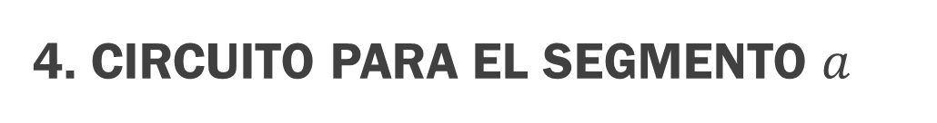







4. Circuito para el segmento $a$
$$a=A+C+BD+B^{′}D′$$
$$A$$
$$B$$
$$C$$
$$D$$
$$B′$$
$$D′$$
$$A+C$$
$$A+C+BD$$
$$BD$$
$$a$$
$$B′D′$$

Slide 6
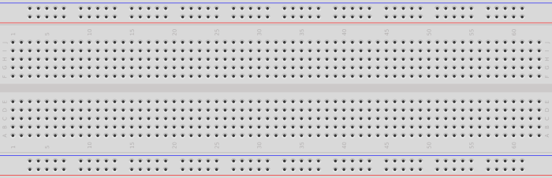

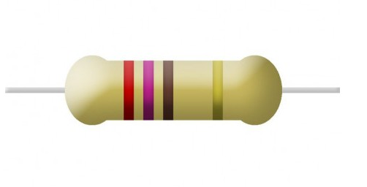
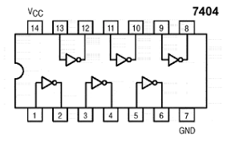
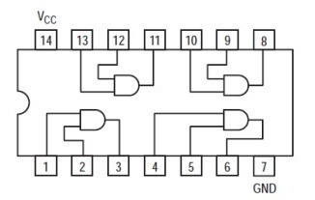
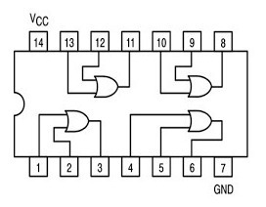

Slide 7
Muchas Gracias
Ing. Mario lópez

